Slide 1
Advanced Software Engineering
Reuse-based software engineering is a software engineering strategy where the development process is geared to reusing existing software.
Reuse-based software engineering is an approach to development that tries to maximize the reuse of existing software
The software units that are reused may be of radically different sizes

Slide 2
Reuse-based software engineering
Application system reuse :The whole of an application system may be reused by incorporating it without changing into other systems or by configuring the application for different customers.
Application system reuse Components of an application, ranging in size from subsys tems to single objects, may be reused.
Object and function reuse Software components that implement a single function, such as a mathematical function, or an object class may be reused.

Slide 3
Reuse-based software engineering
Software systems and components are potentially reusable entities, but their specific nature sometimes means that it is expensive to modify them for a new situation.

Slide 4
Benefits of Re-Use
Some benefits of re-use are:
Increased dependability
Reduced process risk
Effective use of specialists
Effective use of specialists
Accelerated development

Slide 5
Problem of Re-Use
Problems of re-sue
Increased maintenance costs
Lack of tool support
Not-invented-here syndrome (Some software engineers prefer to rewrite components because they believe they can improve on them)
Creating, maintaining, and using a component library
Finding, understanding, and adapting reusable components

Slide 6
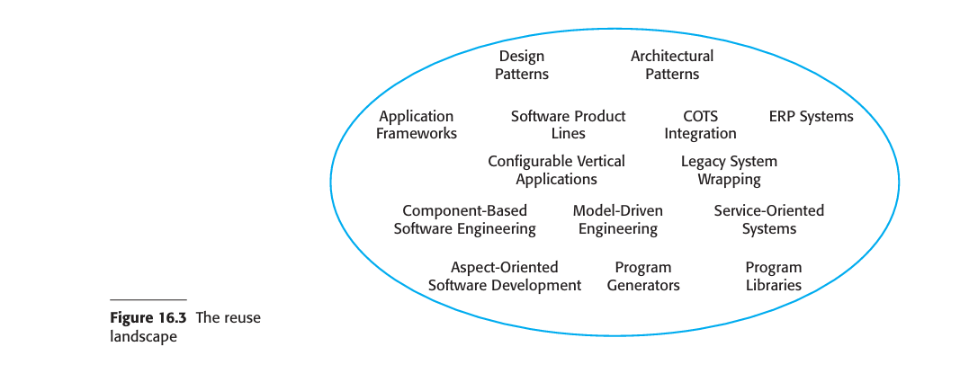
The reuse landscape

Slide 7
Application frameworks
Framework is a generic structure that is extended to create a more specific subsystem or application
Frameworks provide support for generic features that are likely to be used in all applications of a similar

Slide 8
Reasons why frameworks are important:
Standardization: Frameworks provide a standardized way of building applications,
Efficiency: Frameworks often come with built-in features and tools that can speed up development
Modularity: Frameworks often promote modular design, allowing developers to break down applications into smaller, manageable components.
Security: Many frameworks come with built-in security features
Maintainability: Code written using a framework is often easier to maintain and update
Scalability: Frameworks often include features that make it easier to scale applications.

Slide 9
Web application frameworks (WAFs)
Web application frameworks (WAFs) are a more recent and very important type of framework.
WAFs that support the construction of dynamic websites are now widely available.
The architecture of a WAF is usually based on the Model-View Controller (MVC) composite pattern.

Slide 10
Web application frameworks (WAFs)
MVC allows for the separation of the application.
MVC framework supports the presentation of data in different ways and allows interaction with each of these presentations.
When the data is modified through one of the presentations, the system model is changed and the controllers associated with each view update their presentation.

Slide 11
Application Frameworks
Frameworks are implementations of design patterns.
MVC framework includes the Observer pattern.
The general nature of patterns and their use of abstract and concrete classes allows for extensibility.
Without patterns, frameworks would, almost certainly, be impractical.

Slide 12
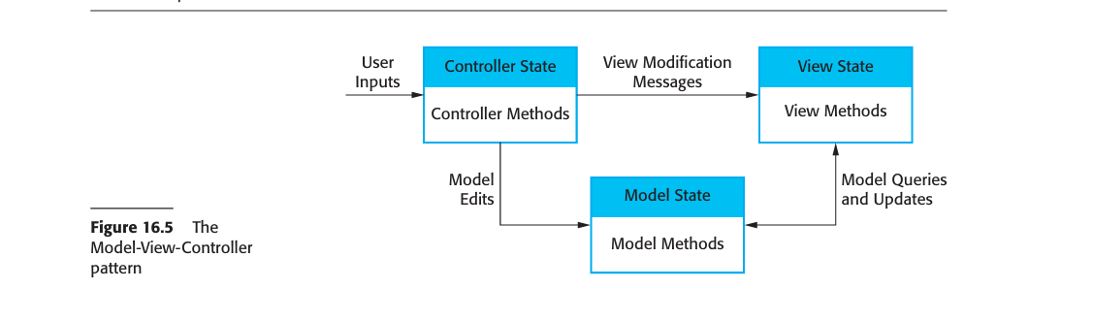
MVC Framework

Slide 13
MVC Framework
Although each framework includes slightly different functionality, most web application frameworks support the following features:
Security
Dynamic web pages
Database support
Session management
User interaction

Slide 14
Software product lines
One of the most effective approaches to reuse is to create software product lines or application families.
A software product line is a set of applications with a common architecture and shared components, with each application specialized to reflect different requirements.
The core system is designed to be configured and adapted to suit the needs of different system customers.
This may involve the configuration of some components, implementing additional components, and modifying some of the components to reflect new requirements

Slide 15
Software product lines
Software product lines usually emerge from existing applications.
That is, an organization develops an application then, when a similar system is required, informally reuses code from this in the new application.
The same process is used as other similar applications are developed.

Slide 16
Software product lines
However, change tends to corrupt application structure so, as more new instances are developed, it becomes increasingly difficult to create a new version.
Consequently, a decision to design a generic product line may then be made.
This involves identifying common functionality in product instances and including this in a base application, which is then used for future development.

Slide 17
Software product lines
The architecture of a software product line often reflects a general, application-specific architectural style or pattern.
For example, consider a product line system that is designed to handle vehicle despatching for emergency services.

Slide 18
Example
This vehicle despatching system is an example of a resource management architecture .
You can see how this four-layer structure is instantiated in Figure 16.8, which shows the modules that might be included in a vehicle despatching system product line.

Slide 19
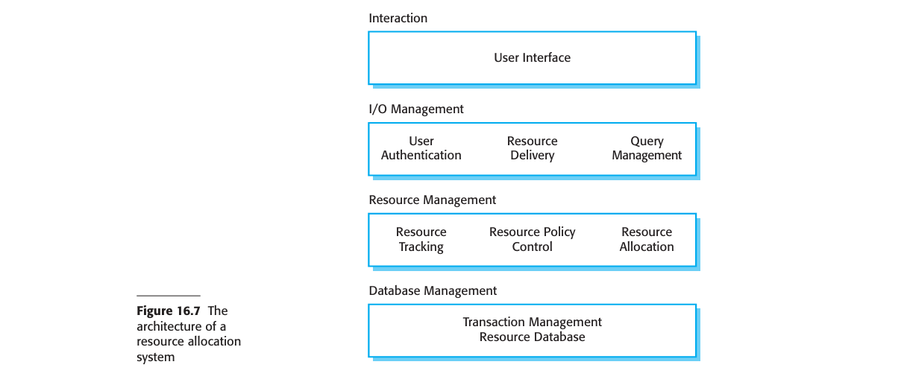
Software product line

Slide 20
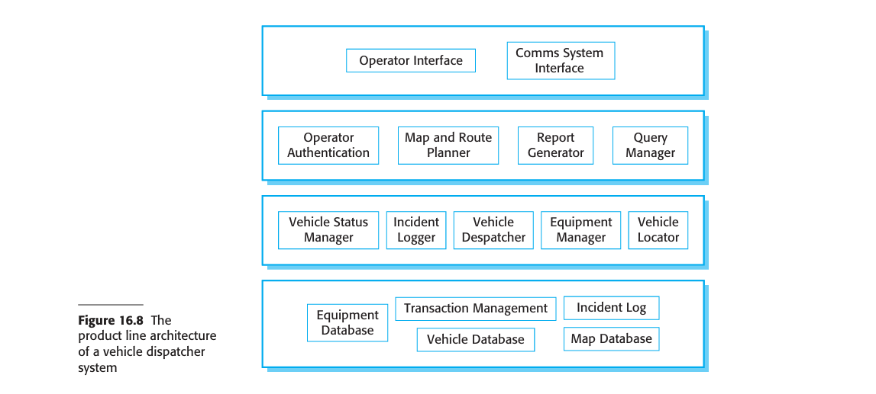
Software product line

Slide 21
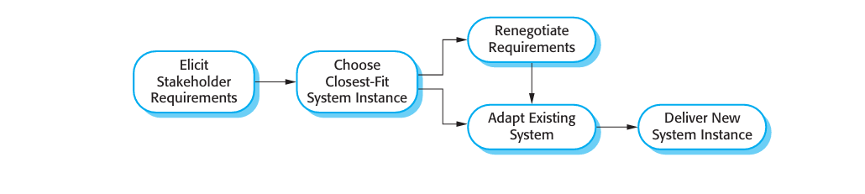
Steps involved in extending a software product line to create a new application.

Slide 22
Steps involved in extending a software product line
Elicit stakeholder requirements
Select the existing system that is the closest fit to the requirements
Renegotiate requirements
Adapt existing system
Deliver new family member

Slide 23
COTS product reuse
A commercial-off-the-shelf (COTS) product is a software system that can be adapted to the needs of different customers without changing the source code of the system.
Virtually all desktop software and a wide variety of server products are COTS software.
Because this software is designed for general use, it usually includes many features and functions.
Open source products were often used as COTS products.
That is, the open source systems were used without change and without looking at the source code.

Slide 24
COTS Benefits
COTS offers significant benefits over customized software
1. As with other types of reuse, more rapid deployment of a reliable system may be possible
2. It is possible to see what functionality is provided by the applications and so it is easier to judge whether or not they are likely to be suitable.
3. Some development risks are avoided by using existing software.

Slide 25
COTS Benefits
4. Businesses can focus on their core activity without having to devote a lot of resources to IT systems development.
5. As operating platforms evolve, technology updates may be simplified as these are the responsibility of the COTS product vendor rather than the customer

Slide 26
COTS approach problems
1. Requirements usually have to be adapted to reflect the functionality and mode of operation of the COTS product. This can lead to disruptive changes to existing business processes.
2. The COTS product may be based on assumptions that are practically impossible to change. The customer must therefore adapt their business to reflect these assumptions.
3. Choosing the right COTS system for an enterprise can be a difficult process, especially as many COTS products are not well documented.

Slide 27
COTS approach problems
4. There may be a lack of local expertise to support systems development. Consequently, the customer has to rely on the vendor and external consultants for development advice. This advice may be biased and geared to selling products and services, rather than meeting the real needs of the customer.
5. The COTS product vendor controls system support and evolution. They may go out of business, be taken over, or may make changes that cause difficulties for customers.

Slide 28
COTS
There are two types of COTS product reuse, namely
COTS-solution systems and COTS-integrated systems. COTS-solution systems consist of a generic application from a single vendor that is configured to customer requirements.
COTS-integrated systems involve integrating two or more COTS systems (perhaps from different vendors) to create an application system

Slide 29
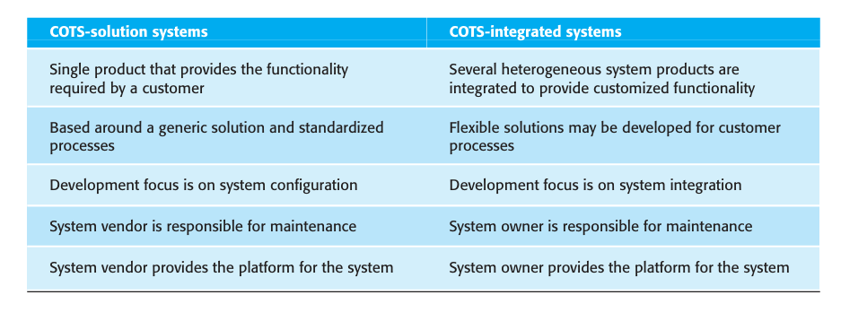
Difference between COTS solution and COTS integrated system

Slide 30
AI in software Engineering
Artificial Intelligence (AI) is increasingly being integrated into software engineering processes, enhancing productivity, improving code quality, and enabling new functionalities.
Here are some key uses of AI in software engineering:

Slide 31
AI in software Engineering
Natural Language Processing (NLP):
AI can facilitate better communication between developers and non-technical stakeholders by converting requirements into technical specifications.
Continuous Learning and Improvement:
Machine learning models can learn from data over time, allowing software systems to improve automatically based on user interactions and feedback.
Enhanced Security:
AI can help in identifying vulnerabilities in software and systems, providing more robust security measures against potential threats.

Slide 32
Uses of AI in software Engineering
Automated Code Generationa: can assist in generating code snippets or even entire functions based on natural language descriptions. Tools like GitHub Copilot utilize machine learning to interpret user intent and produce code automatically.
Code Review and Quality Assurance: AI can analyze code for potential bugs, vulnerabilities, and stylistic issues. Tools like DeepCode use machine learning algorithms to identify code smells and suggest improvements, thus enhancing code quality.
Testing and Debugging: AI can automate testing processes by generating test cases
Security Enhancements: AI can help identify security vulnerabilities
Requirement Analysis: AI tools can help in analyzing and prioritizing requirements by processing user stories, feedback, and market analysis, ensuring that the development team focuses on features that deliver the most value.

Slide 33
Uses of AI in software Engineering
Natural Language Processing (NLP): NLP can be used to analyze user feedback, bug reports, and documentation. AI-driven chatbots can also assist in customer support and provide real-time assistance to developers.
DevOps Automation: AI can optimize CI/CD pipelines by predicting build failures and automating deployment processes. It can also monitor application performance and predict when maintenance is required.
Intelligent Code Assistants: AI-powered IDE plugins can provide context-aware suggestions, auto-completion, and even code refactoring recommendations based on best practices and project-specific guidelines.
User Experience Enhancement: AI can analyze user interactions and behavior patterns to inform UI/UX design decisions, leading to more intuitive and user-friendly applications.

Slide 34
Advantages of Using AI in Software Engineering
Increased Efficiency and Productivity:
AI can automate repetitive tasks such as code generation, testing, and debugging, allowing engineers to focus on more complex problems.
Enhanced Code Quality:
AI tools can analyze code for potential errors and suggest improvements, leading to higher code quality and reduced bug rates.
Predictive Analytics:
AI can predict project risks, timelines, and resource needs, helping teams make better decisions and manage projects more effectively.
Improved Testing:
AI-driven testing tools can generate test cases, simulate user behavior, and identify edge cases, enhancing the software testing process.
Better User Experience:
AI can help in personalizing user experiences through algorithms that analyze user behavior and preferences

Slide 35
Demerits of Using AI in Software Engineering
High Initial Costs:
Implementing AI solutions can be expensive due to the need for specialized tools, infrastructure, and training.
Complexity:
AI systems can introduce complexity into software development, making it difficult to understand and manage.
Dependence on Data:
AI requires large amounts of high-quality data to function effectively, which may not always be available.
Job Displacement:
Automation of certain tasks may lead to job losses or shifts in job roles within software engineering teams.

Slide 36
Demerits of Using AI in Software Engineering
Bias and Ethical Concerns:
AI systems can perpetuate biases present in the training data, leading to unfair or unethical outcomes in software applications.
Maintenance Challenges:
AI models require ongoing monitoring and maintenance to ensure they continue to perform correctly, which can be resource-intensive.
Potential for Over-Reliance:
Developers may become overly reliant on AI tools, potentially leading to a decline in fundamental programming skills.
Security Risks:
AI systems can be vulnerable to adversarial attacks, where malicious actors manipulate inputs to deceive the AI, leading to incorrect outputs.

Slide 37
Uses of Cloud Computing in Software Engineering
Cloud computing has significantly transformed software engineering practices, offering a range of benefits and capabilities that enhance development, deployment, and maintenance processes.
Here are some key uses of cloud in software engineering:
Infrastructure as a Service (IaaS):
Provides virtualized computing resources over the internet, allowing developers to rent servers, storage, and networking without the need for physical hardware.
Enables quick scaling of resources to meet varying workloads.
Platform as a Service (PaaS):
Offers a platform allowing developers to build, deploy, and manage applications without dealing with the underlying infrastructure.
Facilitates rapid development with built-in tools for testing, integration, and deployment.

Slide 38
Uses of Cloud Computing in Software Engineering
Software Development and Collaboration:
Cloud-based collaboration tools (e.g., GitHub, GitLab) enable version control, code reviews, and team collaboration.
Facilitates remote work and collaboration among geographically dispersed teams.
Continuous Integration/Continuous Deployment (CI/CD):
Cloud services support CI/CD pipelines, automating the process of integrating code changes and deploying applications.
Tools like Jenkins, Circle CI, and Git Hub Actions can be easily integrated with cloud services.
Microservices Architecture:
The cloud provides an ideal environment for deploying micro services, enabling independent scaling, development, and maintenance of different application components.
Services like Kubernetes and Docker can be easily utilized in the cloud for container orchestration.
Serverless Computing:
Allows developers to run code in response to events without provisioning or managing servers, reducing operational overhead.
Services like AWS Lambda, Azure Functions, and Google Cloud Functions simplify the execution of backend processes.

Slide 39
Cloud Services Uses
Disaster Recovery and Backup:
Cloud solutions provide easy and cost-effective options for data backup and disaster recovery, ensuring business continuity.
Automated backup solutions can be configured to protect critical application data.
Scalability and Elasticity:
Applications can be scaled up or down based on demand, allowing for efficient resource utilization and cost management.
Load balancers and auto-scaling features in cloud environments help manage traffic spikes effectively.
Security and Compliance:
Cloud providers invest heavily in security measures and compliance certifications, offering services such as identity and access management, encryption, and threat detection.
Developers can leverage these security features to build more secure applications.
Artificial Intelligence and Machine Learning:
Cloud platforms provide access to AI and ML services, making it easier for developers to incorporate advanced analytics and machine learning capabilities into their applications.
Services like AWS SageMaker, Azure Machine Learning, and Google AI Platform facilitate the development and deployment of machine learning models.

Slide 40
Advantages of Using Cloud Services in Software Development
Scalability: Cloud services allow developers to easily scale resources up or down based on demand. This flexibility is particularly beneficial for applications with fluctuating workloads.
Cost Efficiency: Many cloud providers offer pay-as-you-go pricing models, which can reduce upfront costs. Organizations can avoid the expense of purchasing hardware and only pay for the resources they use.
Accessibility: Cloud services enable developers to access their work from anywhere with an internet connection. This facilitates remote collaboration and supports distributed teams.
Rapid Deployment: Cloud platforms often provide tools and services that streamline the development process, allowing for faster deployment of applications and updates.
Automatic Updates: Cloud providers typically manage software updates, ensuring that developers are working with the latest tools and technologies without manual intervention.

Slide 41
Advantages of Using Cloud Services in Software Development
Enhanced Collaboration: Cloud services often come with integrated collaboration tools, making it easier for teams to work together on projects in real-time.
Disaster Recovery and Backup: Many cloud providers offer built-in backup and disaster recovery solutions, which can help protect data and minimize downtime in case of failures.
Access to Advanced Technologies: Cloud platforms often provide access to advanced technologies (like AI, machine learning, and big data analytics) that might be difficult to implement on-premises.
Security: Major cloud providers invest heavily in security measures, providing better protection for data than many organizations could achieve on their own.

Slide 42
Disadvantages of Using Cloud Services in Software Development
Dependency on Internet Connectivity: Cloud services require a stable internet connection. Any downtime or slow connections can hinder development and access to resources.
Vendor Lock-In: Organizations may become dependent on a specific cloud provider's tools and services, making it challenging to switch providers or migrate to on-premises solutions.
Limited Control: Using cloud services means relinquishing some control over infrastructure and security protocols, which may not align with specific organizational policies.
Compliance and Regulatory Issues: Storing data in the cloud may raise compliance concerns, especially for industries with strict regulations regarding data privacy and security.
Potential for Increased Costs: While cloud services can be cost-effective, poorly managed resources can lead to unexpected costs, especially if usage spikes or if services are not properly configured.
require real-time processing.

Slide 43
Disadvantages of Using Cloud Services in Software Development
Performance Variability: Cloud services can experience performance fluctuations based on shared resources, which might affect application performance during peak usage times.
Data Security and Privacy Concerns: While cloud providers typically offer robust security measures, there is still a risk of data breaches, and organizations must ensure that their data is protected.
Complexity in Management: Managing multiple cloud services can become complex, especially if different teams use different platforms, leading to potential integration and management challenges.
Latency Issues: Depending on the geographical location of the cloud data centers, latency might be a concern for applications that

